Slide 1


Slide 2
DESIGN OF A MODULAR, AXIAL-FLUX DIRECT DRIVE PERMANENT MAGNET GENERATOR FOR WIND TURBINES
Aydın BAŞKAYA
January 17, 2018
METU EEE

Slide 3
Outline
Introduction
Review Of Wind Energy Conversion (WEC) Systems
Design Of The Proposed Axial Flux Generator
Optimization And Design
FEA Verification Of Analytical Design
Conclusions

Slide 4
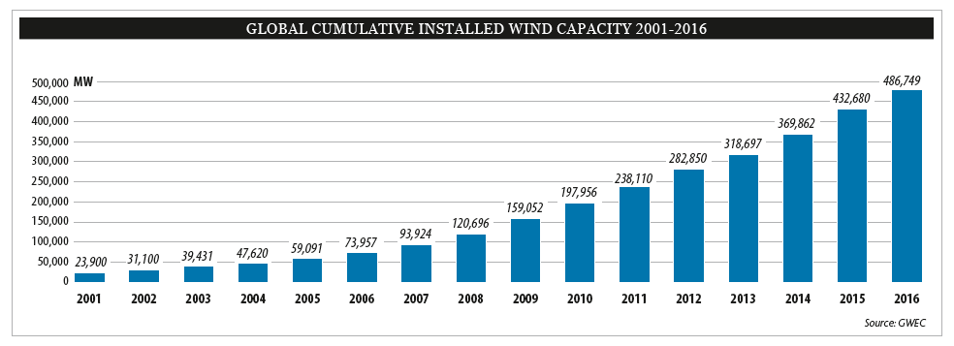
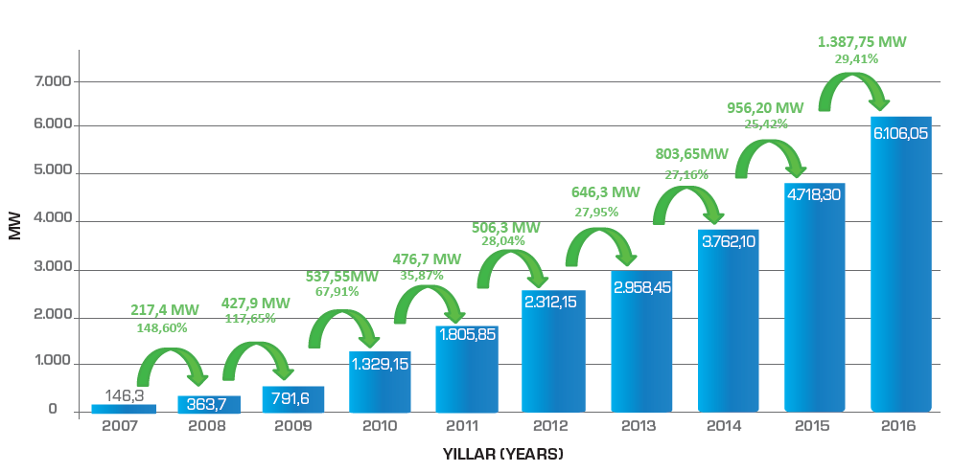
Background of Wind Energy Harvesting
Energy crisis in 1970s and environmental problems worked as a catalyst in development progress of wind turbines
Turkish Case(6% - 2015):
83 country, 24 country >1GW worldwide
[6]

Slide 5
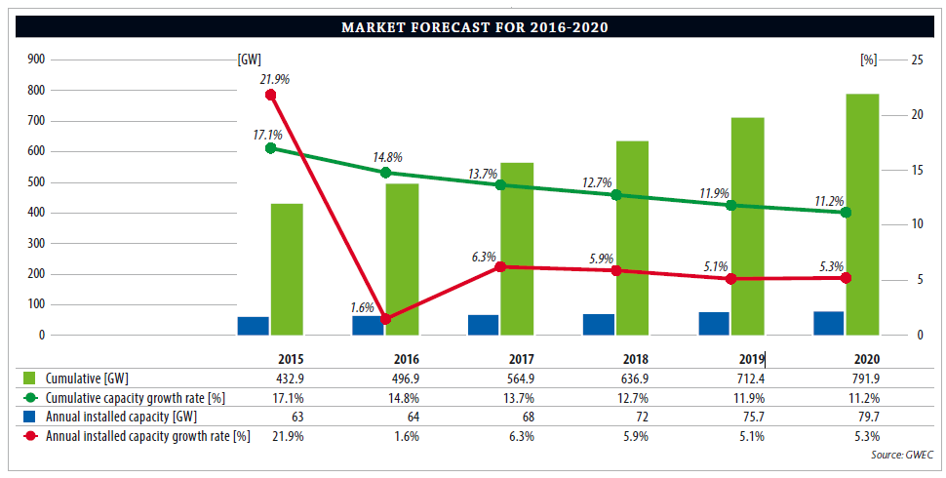
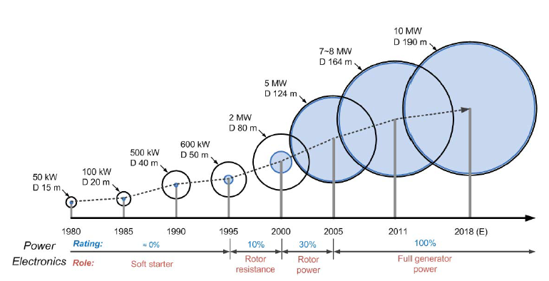
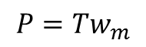
Market Forecast:
Sizes and power levels of WPPs are increased, hence importance of efficiency and grid connection subjects are also increased.
Grid support
DD generators have larger diameters.
$$P=Tw_{m}$$
[8]

Slide 6
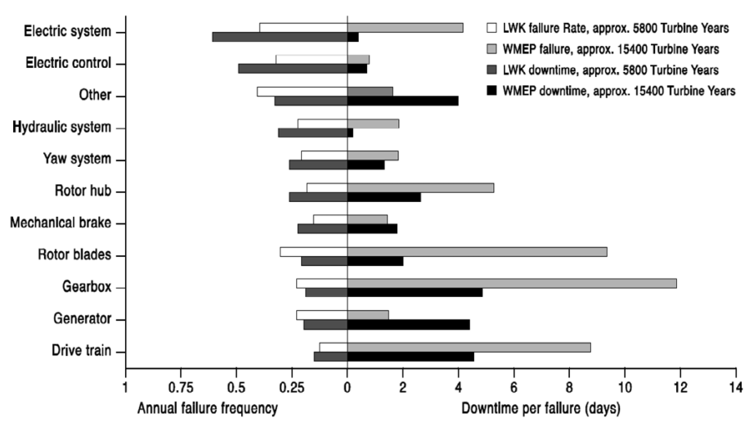
Problem Statement and Research Objective
[29]
Gearbox and drivetrain failures are the main reasons of the longest downtimes
Need for regular maintenance, mechanical & thermal losses, reduced efficiency)
Increasing importance of Reliability, Efficiency, Modularity, Fault tolerance, Reduced maintenance costs

Slide 7
Outline
Introduction
Review Of Wind Energy Conversion (WEC) Systems
Design Of The Proposed Axial Flux Generator
Optimization And Design
FEA Verification Of Analytical Design
Conclusions

Slide 8
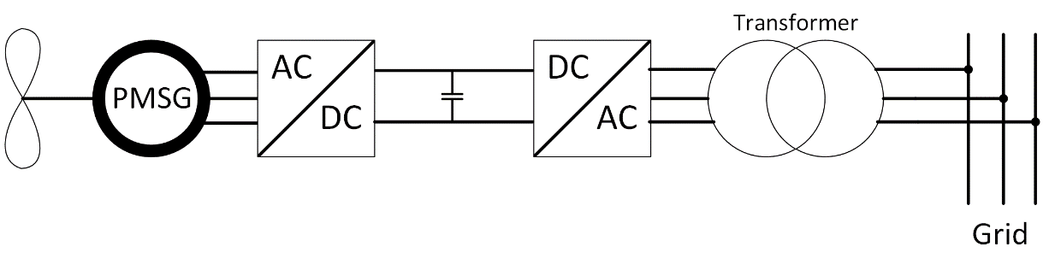
Current Wind Turbine Generator Technologies
Induction Generators
SCIG, WRIG, DFIG
Synchronous Generators
EESG, PMSG-SELECTED TYPE
(+) Full-scale power converter, variable speed, higher energy yield and efficiency
(-) Magnet prices, large diameter and mass(DD)

Slide 9
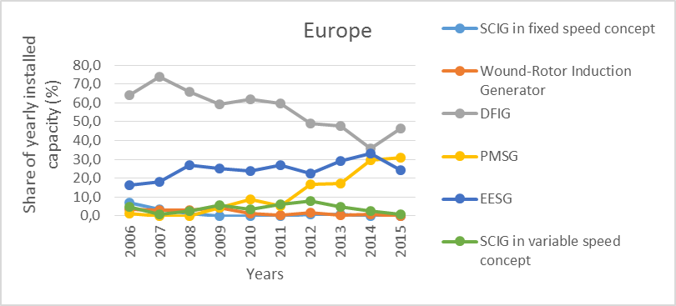
Current Wind Turbine Generator Technologies
Europe trends on WECs:
[41]

Slide 10
Outline
Introduction
Review Of Wind Energy Conversion (WEC) Systems
Design Of The Proposed Axial Flux Generator
Optimization And Design
FEA Verification Of Analytical Design
Conclusions

Slide 11
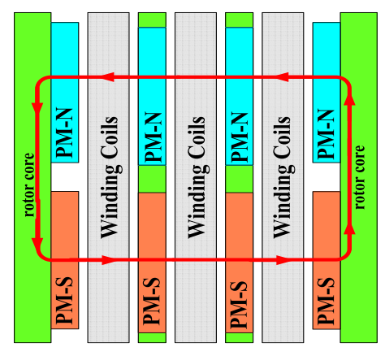
Flux Orientations
RFPM
Low torque/volume , long axial length
AFPM SELECTED TYPE
High torque density, axial length advantage , multistage flexibility
TFPM
Low power factor, complex structure
[54]

Slide 12
Proposed Generator
Single stage of the selected AFPM generator

Slide 13
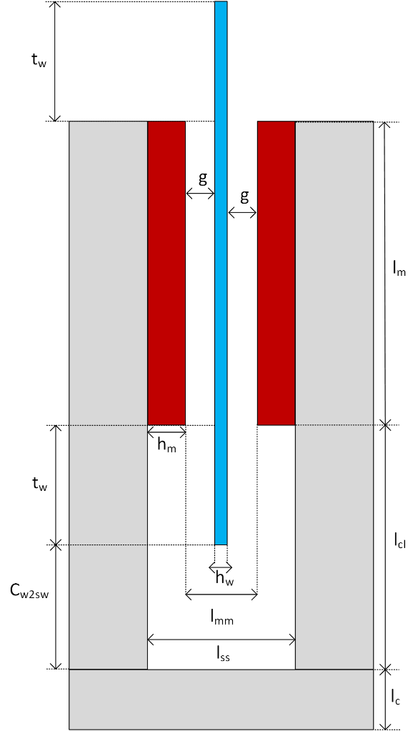
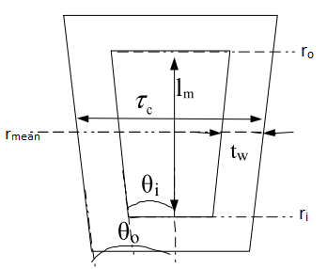
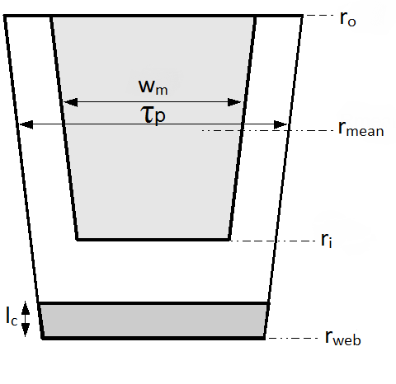
Proposed Generator
Half cross section of C-core
Counter view of winding
Counter view of one pole

Slide 14
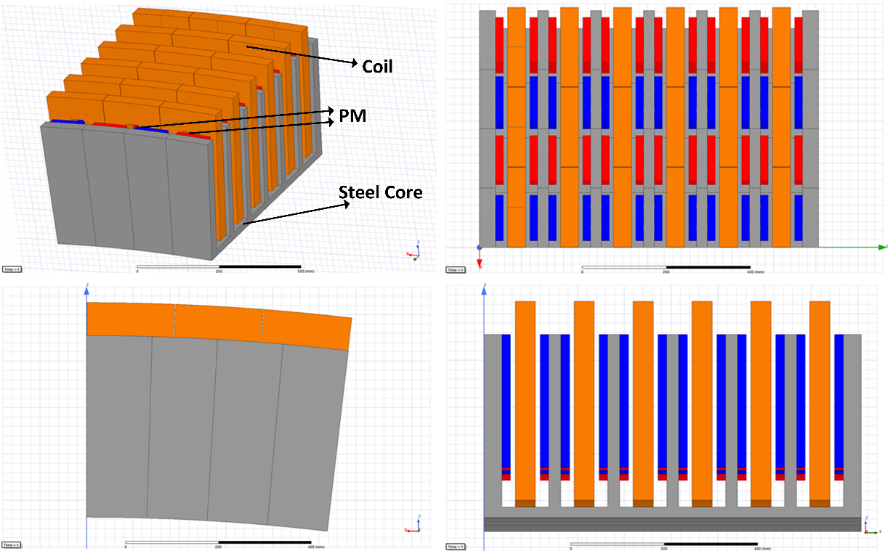
Proposed Generator
There is a 4/3 ratio between coil pitch and pole pitch in order to get higher induced voltage.

Slide 15
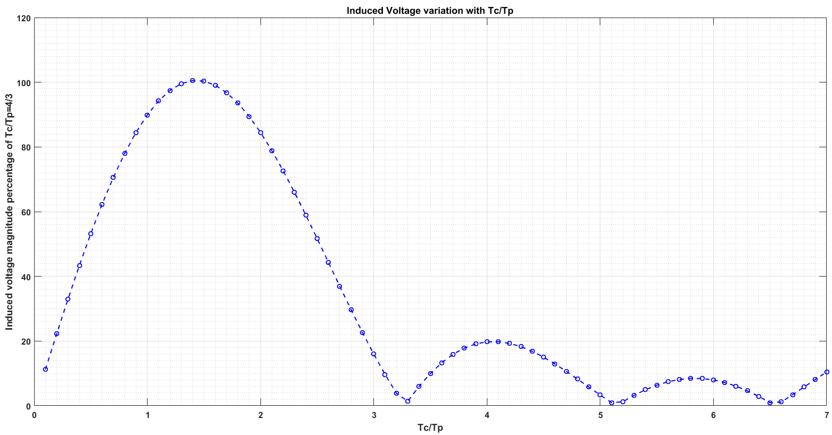
Proposed Generator

Slide 16
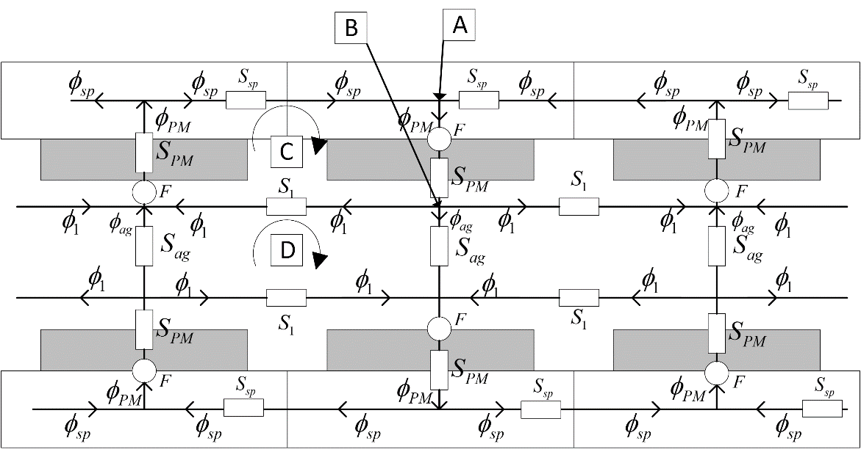
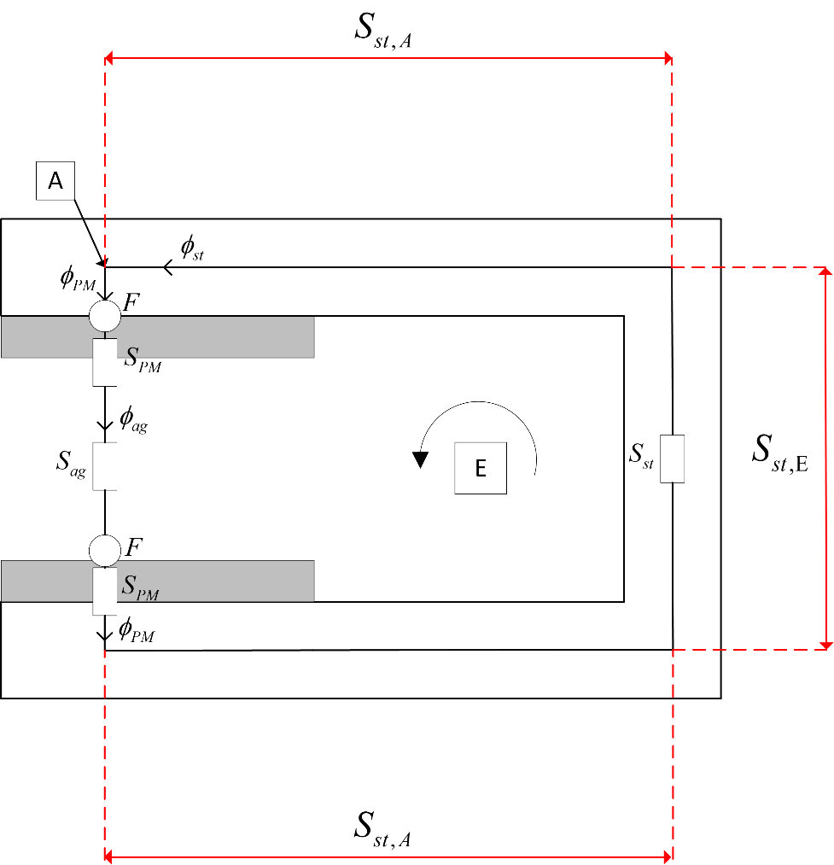
Reluctance network

Slide 17
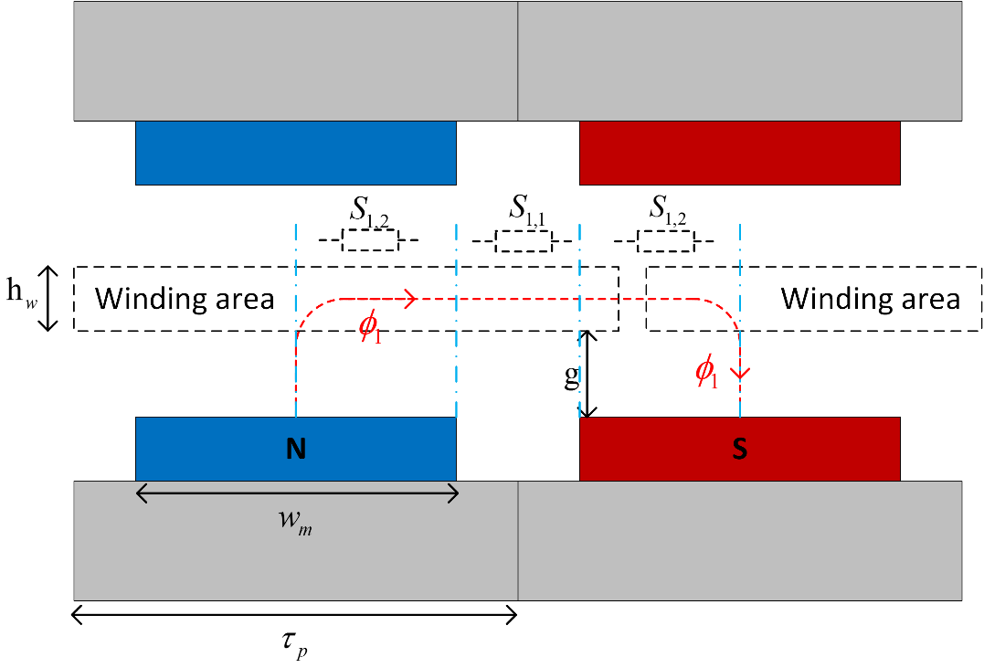
Reluctance network
Magnet-magnet leakage fluxes are taken into account

Slide 18
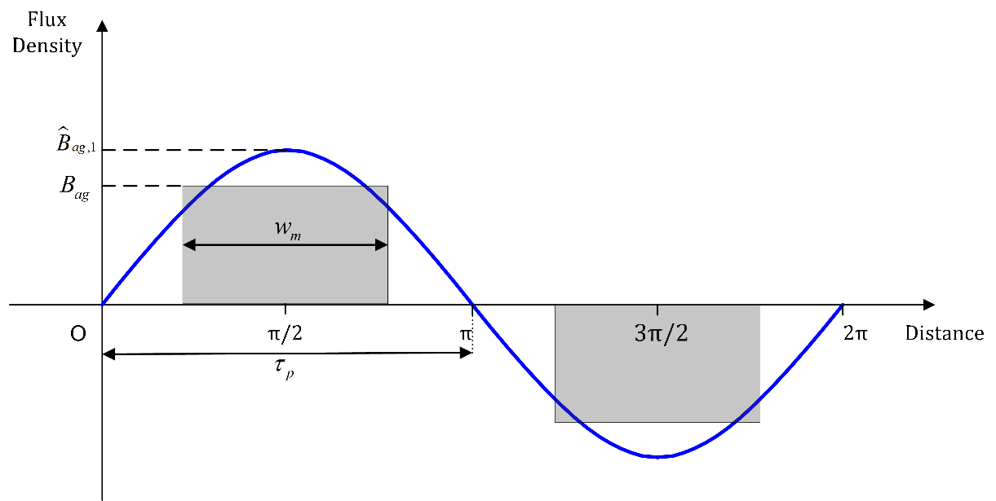
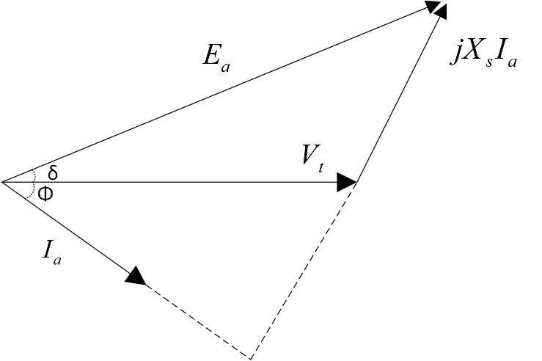
Flux Density waveform

Slide 19
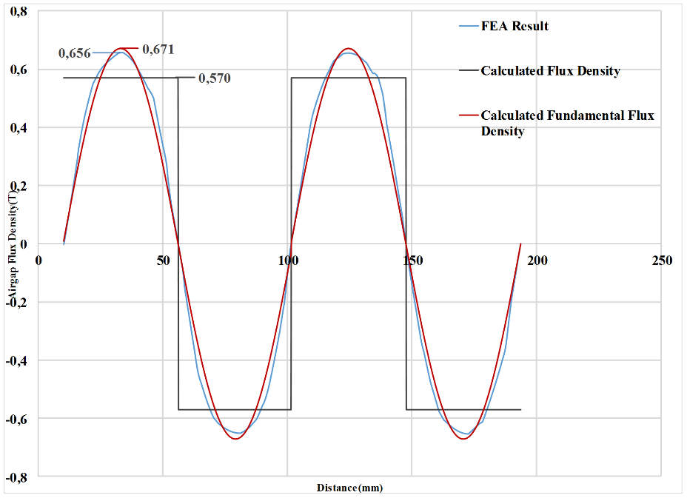
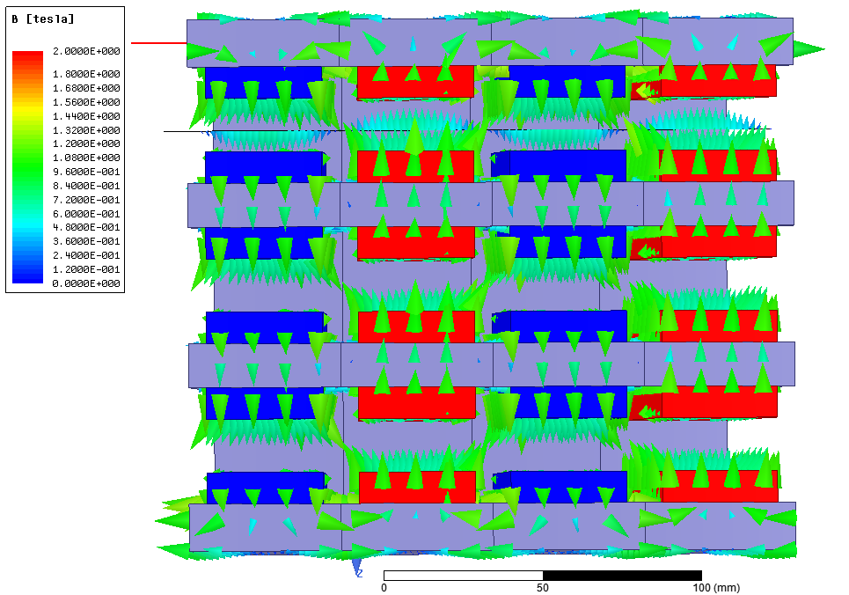
50 kW/60 rpm sample verification
 | Analytical | FEA | Error
Peak Airgap Flux Density | 0.67 T | 0.65 T | 3%
Peak Induced Emf E_{ph,peak} | 1496 V | 1600 V | 6.5%

Slide 20
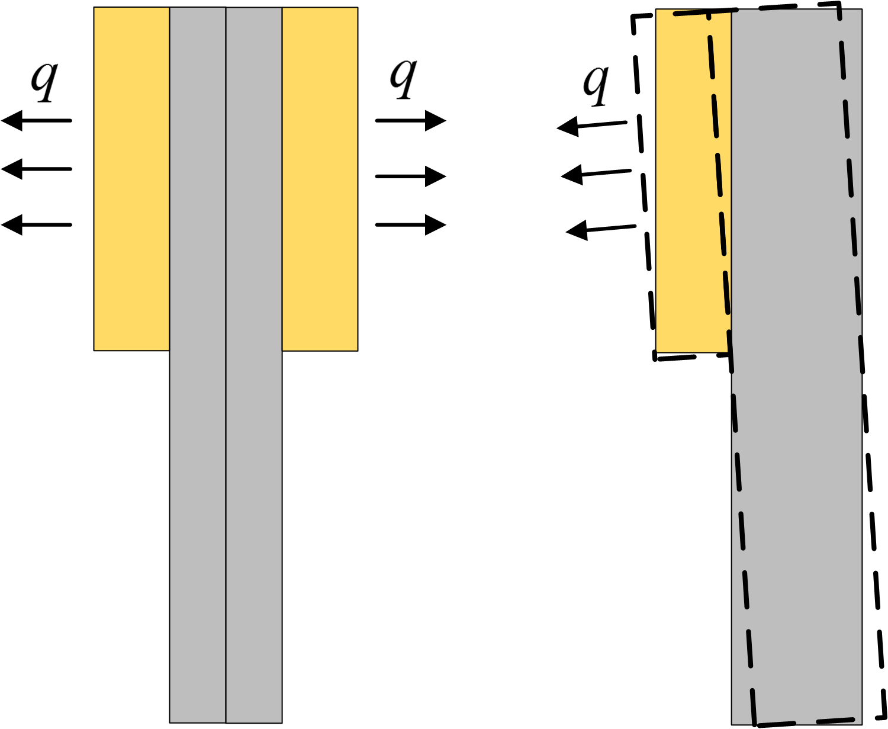
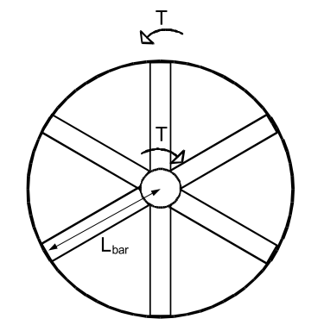
Structural deflection
Deflection should be below 10% with respect to air gap clearance [71]-[73]
Beam model is used in the calculation of C-Core deflection
Thermal Approach
Forced air cooling selected
Reference current density is used as 7 A/mm² [50],[79]
8 rotor bars and 6 stator bars[66]

Slide 21
Outline
Introduction
Review Of Wind Energy Conversion (WEC) Systems
Design Of The Proposed Axial Flux Generator
Optimization And Design
FEA Verification Of Analytical Design
Conclusions

Slide 22
Optimization Characteristics
Genetic Algorithm is selected for the cost-based optimization method.
15 different design parameters of the proposed generator are optimized.
Air gap is selected as constant (10 mm-from 1/1000)[47][82]
Objective function is defined as:

Slide 23
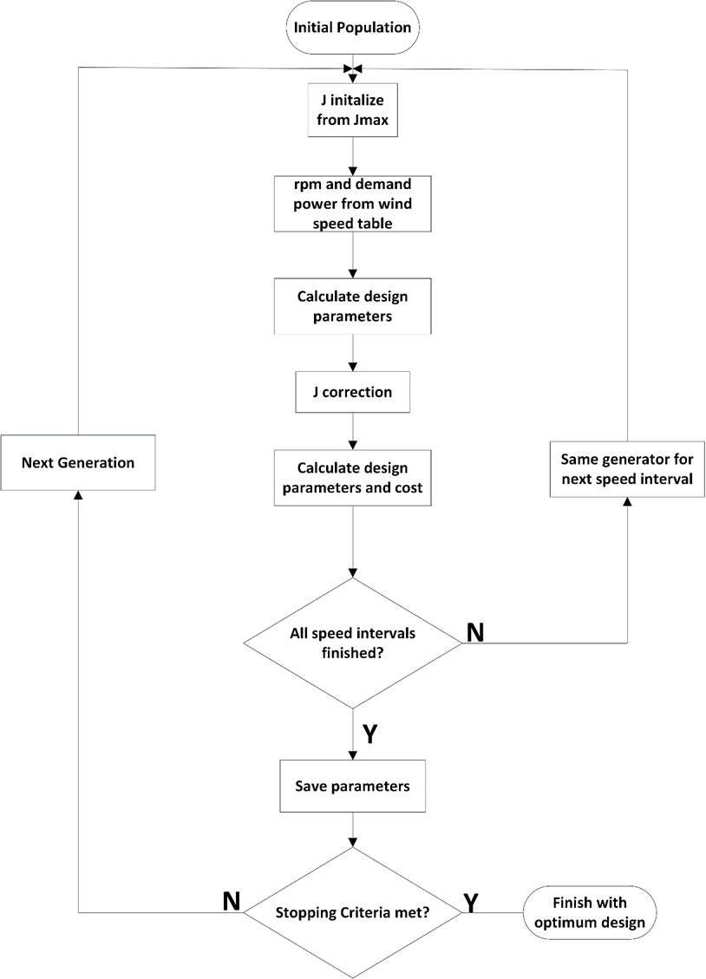
Optimization Characteristics
Population Size=100
Number of Generation=200
9 speed intervals with real wind probabalistic
7 different penalty functions

Slide 24
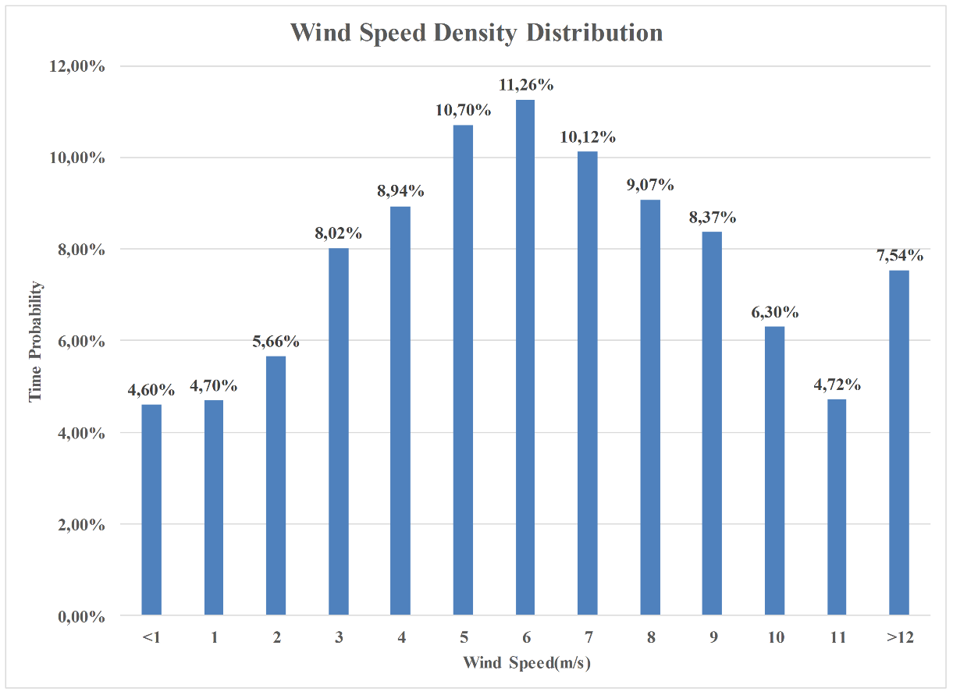
Optimization Characteristics
Koru RES/Çanakkale (52.8 MW) wind speed statistics are processed in MATLAB

Slide 25
Optimization Characteristics
GAMESA-G128 (5MW) generation curve data is used for targeted generation
Wind Speed | Average Speed (rpm) | Average Torque (kNm) | Output Power (kW) | Time Probability | Energy Ratio
4 m/s | 1 | 187.5 | 195 | 31,92% | 4,09%
5 m/s | 1 | 4038,5 | 420 | 10,70% | 2,95%
6 m/s | 2.9 | 2606,1 | 786 | 11,26% | 5,81%
7 m/s | 4.8 | 2596,2 | 1296 | 10,12% | 8,61%
8 m/s | 6.7 | 2788,5 | 1943 | 9,07% | 11,57%
9 m/s | 8.6 | 3017,7 | 2699 | 8,37% | 14,84%
10 m/s | 10.5 | 3193,2 | 3487 | 6,30% | 14,43%
11 m/s | 12 | 3344,6 | 4174 | 4,72% | 12,94%
>12 m/s (Rated) | 12 | 4006,4 | 5000 | 7,54% | 24,76%
Weighted Average (time) | 4.7 | 2154,9 | 1522,6 | 100,00% | 100,00%

Slide 26
Optimization Characteristics
Penalty functions are used to convert a constrained problem to an unconstrained problem
Penalty Function | Constraint | Penalty Coefficient | Coefficient Value
 | Efficiency |  | =5x10⁴ =3x10⁷
 | Deflection |  | 10⁵
 | Axial length |  | 10⁵
 | Outer diameter |  | 10⁸
 | Temperature |  | 10⁵
 | Power |  | =0.1 =1
 | Voltage |  | 10⁶

Slide 27
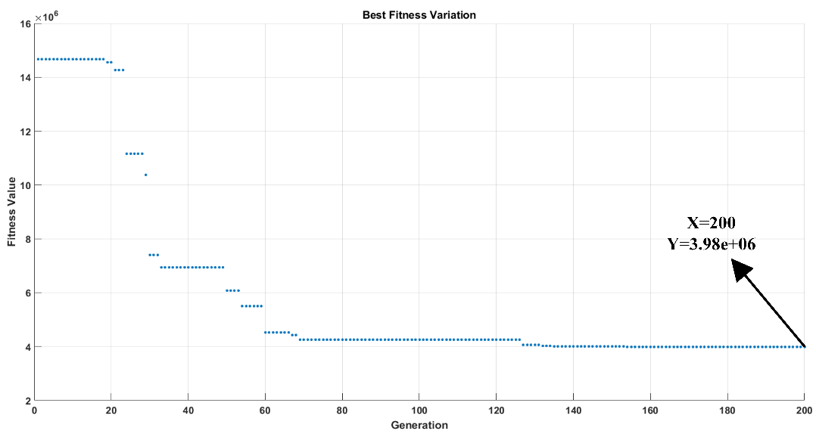
Optimized 5MW/12 rpm Generator
Best fitness variation:

Slide 28
Optimized 5MW/12 rpm Generator
Optimized design parameters (Independent variables):
Parameter | Value
Mean radius- | 4.71 m
Speed | 12 rpm
Number of poles- | 216
Number of parallel stacks- | 6
Outer limb thickness- | 38 mm
Inner limb thickness- | 25.3 mm
Steel web thickness- | 22.4 mm
Number of turns- | 42
Current density- | 2.47 A/mm²
Number of branch- | 6
Height of the winding- | 43 mm
Winding thickness/Coil pitch ratio- | 0.388
Magnet/Steel width ratio- | 0.76
Fill factor- | 0.69
Height of the magnet- | 18.8 mm
Length of the magnet- | 282.7 mm

Slide 29
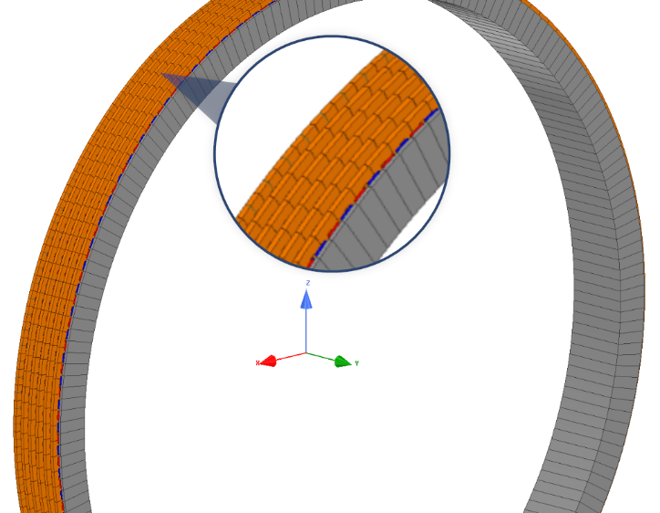
Optimized 5MW/12 rpm Generator

Slide 30
Optimized 5MW/12 rpm Generator
Some of the salient features at rated speed of 12 rpm:
Feature | Value
Mean radius | 4.71 m
Stator outer diameter | 9.9 m
Air gap | 10 mm
Number of poles | 216
Number of turns | 42
Axial length | 1.0 m
Number of axial stack | 6
Voltage per phase (rms) | 371.88 V
Current per phase | 746.9 A
Total copper loss | 206.9 kW
Total eddy loss | 30.1 kW
Net output power | 4992 kW
Efficiency | 95.4%
Phase reactance | 0.111 Ω
Phase resistance | 0.020 Ω
Power factor | 1
Total mass | 119.4 tonne
Material cost | $ 1.30 M
Total cost (including labor) | $ 1.56 M
Total Electricity Generation (annual) | 11.73 GWh
Total Generation Income (annual) | $ 857k

Slide 31
Optimized 5MW/12 rpm Generator

Slide 32
Optimized 5MW/12 rpm Generator
Performance ratings:
Wind Speed | Rpm | (A/mm²) | (V) | (A) | Desired Power (kW) | Input Power (kW) | Output Power (kW) | Efficiency (%)
4 m/s | 1 | 1.37 | 24.4 | 414.1 | 195 | 244 | 182 | 74.5
5 m/s | 1 | 2.10 | 19.5 | 636.4 | 420 | 372 | 223 | 60.0
6 m/s | 2.9 | 1.69 | 84.3 | 512.0 | 786 | 874 | 777 | 88.8
7 m/s | 4.8 | 1.62 | 146.9 | 489.1 | 1296 | 1385 | 1293 | 93.4
8 m/s | 6.7 | 1.71 | 208.0 | 518.7 | 1943 | 2049 | 1942 | 94.7
9 m/s | 8.6 | 1.85 | 268.7 | 558.3 | 2699 | 2829 | 2700 | 95.4
10 m/s | 10.5 | 1.95 | 329.4 | 588.5 | 3487 | 3639 | 3490 | 95.8
11 m/s | 12 | 2.03 | 377.1 | 615.5 | 4174 | 4346 | 4178 | 96.1
12 m/s | 12 | 2.47 | 371.4 | 746.9 | 5000 | 5230 | 4992 | 95.4

Slide 33
Outline
Introduction
Review Of Wind Energy Conversion (WEC) Systems
Design Of The Proposed Axial Flux Generator
Optimization And Design
FEA Verification Of Analytical Design
Conclusions

Slide 34
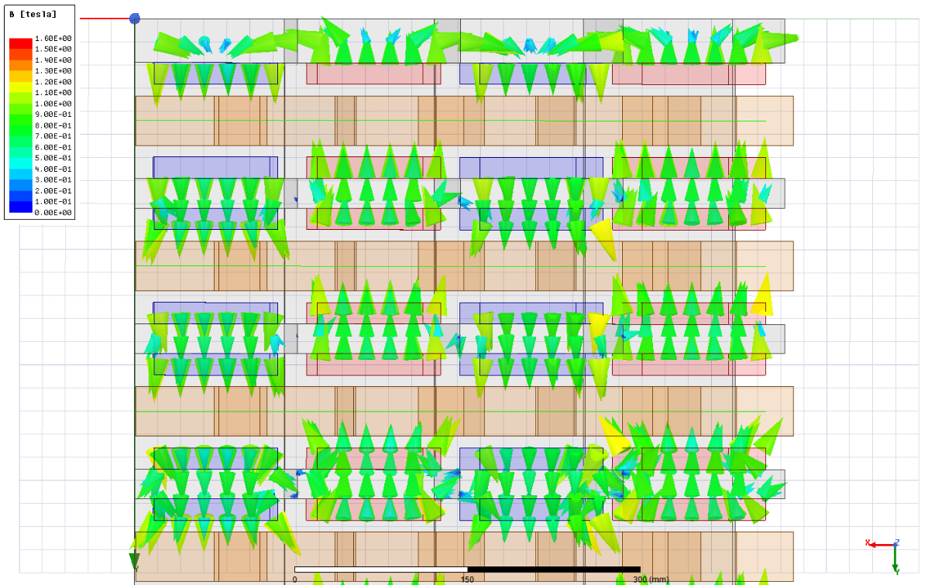
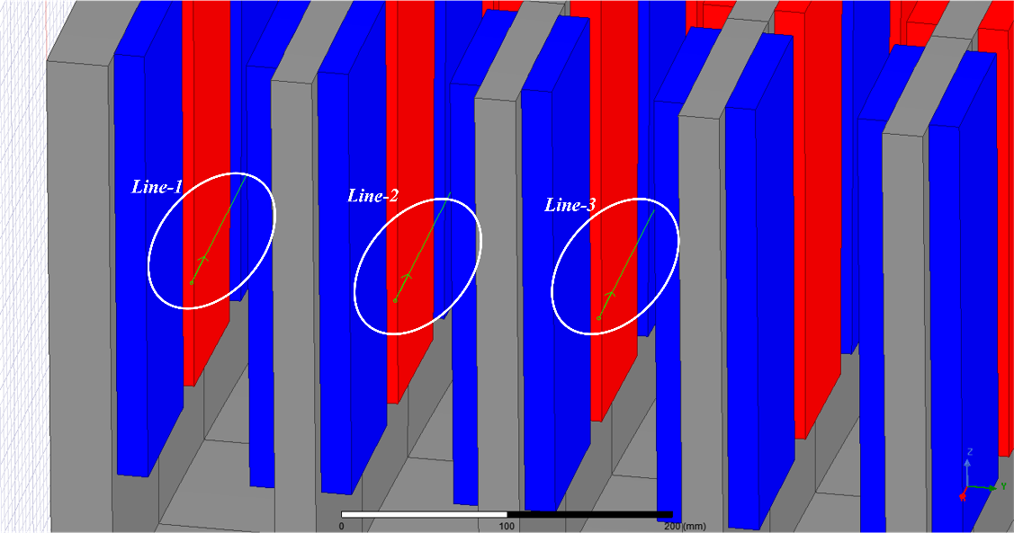
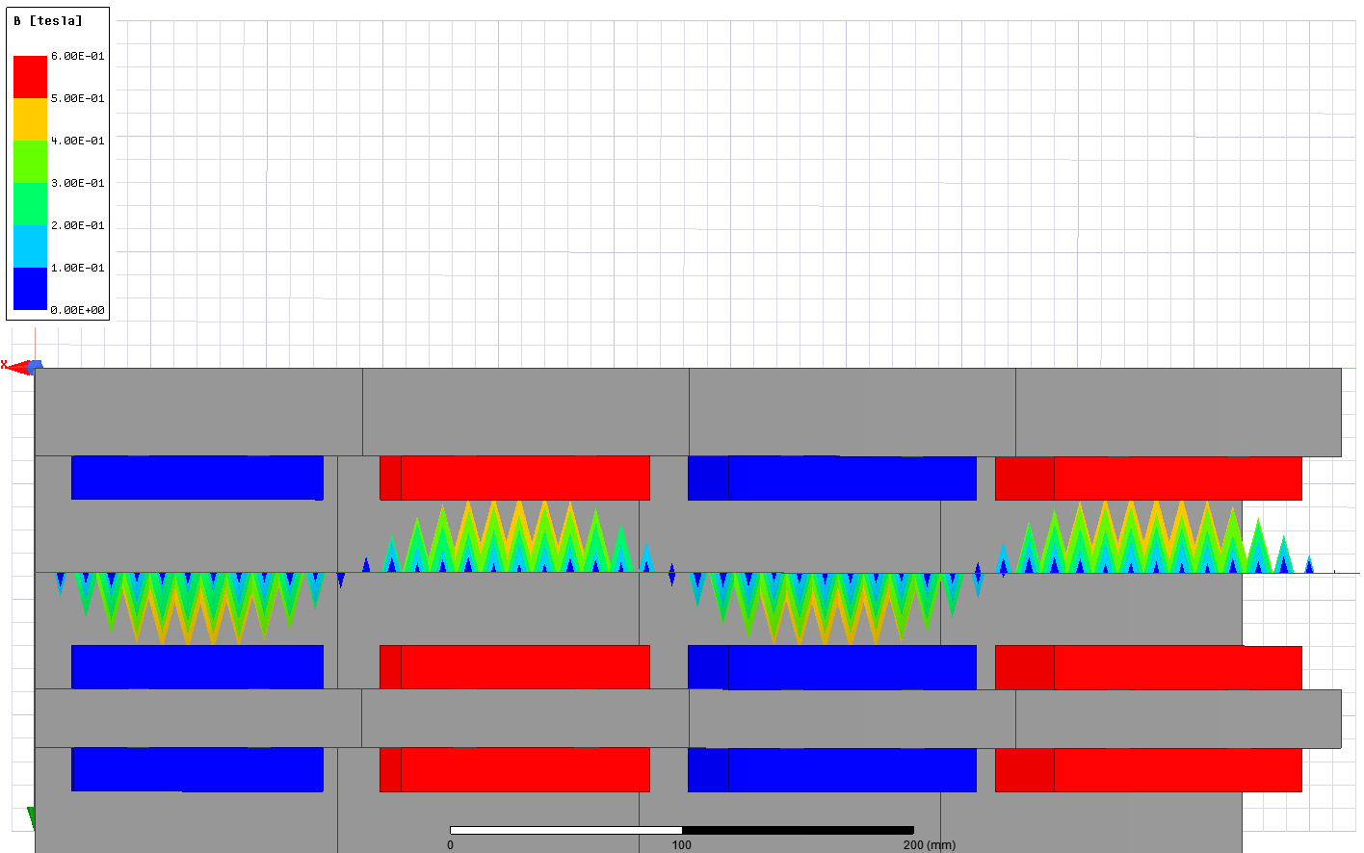
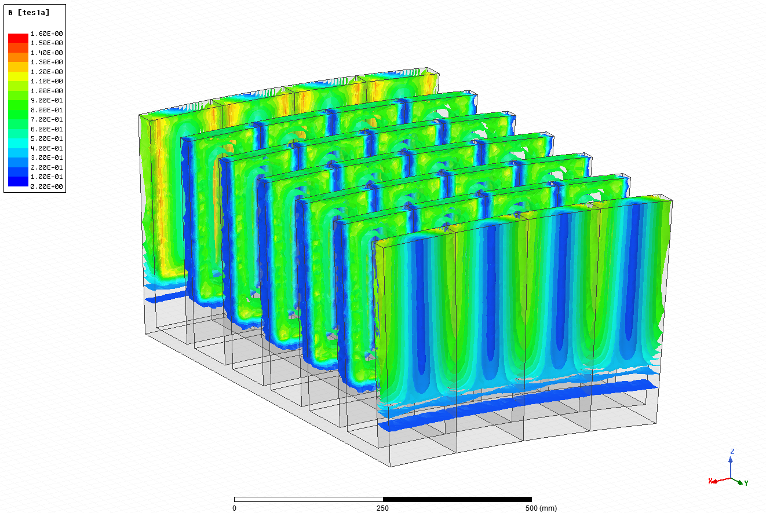
Air gap flux density verification

Slide 35
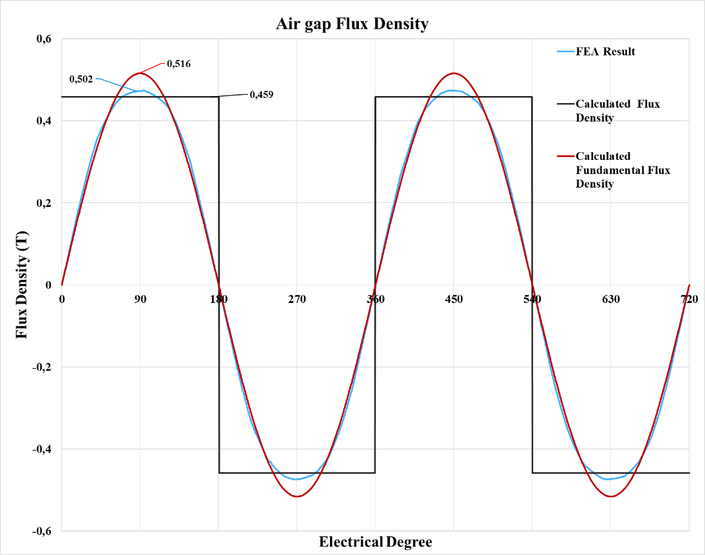
Air gap flux density verification
Property | FEA | Analytical | Error
Air gap flux density - (peak) | 0.474 T | 0.459 (flat-top) T | 3.1%
Air gap flux density fundamental- (peak) | 0.502 T | 0.516 T | 2.7%

Slide 36
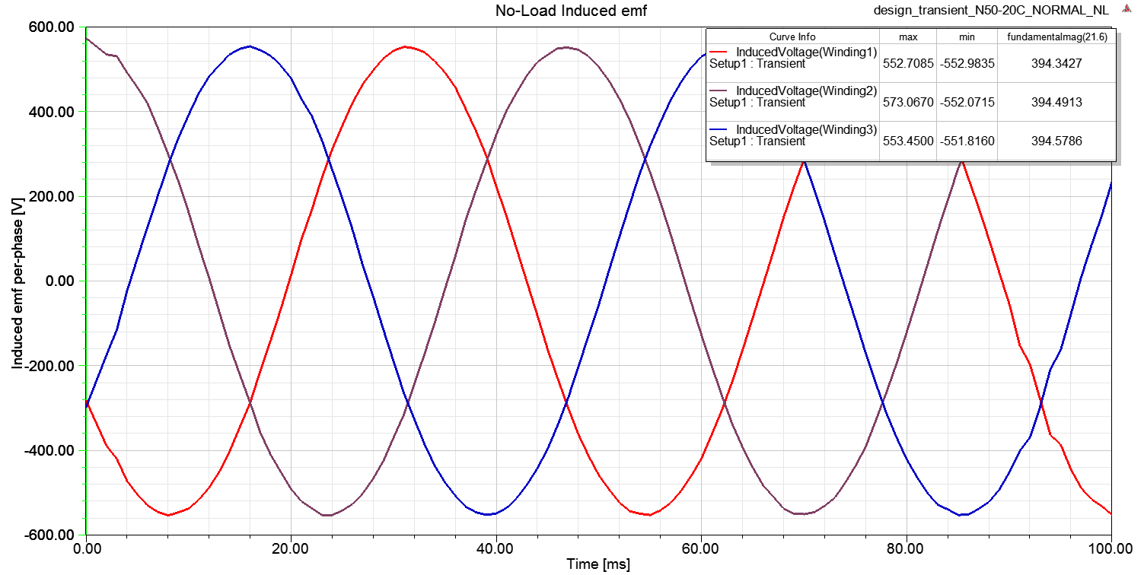
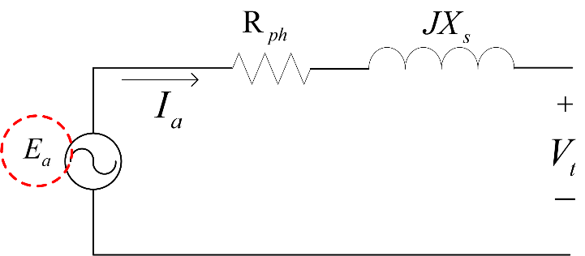
No-load analysis
Property | FEA Value (V) | Analytical Value (V) | Error
Induced emf per-phase rms | 394.5 | 395.6 | 0.27%

Slide 37
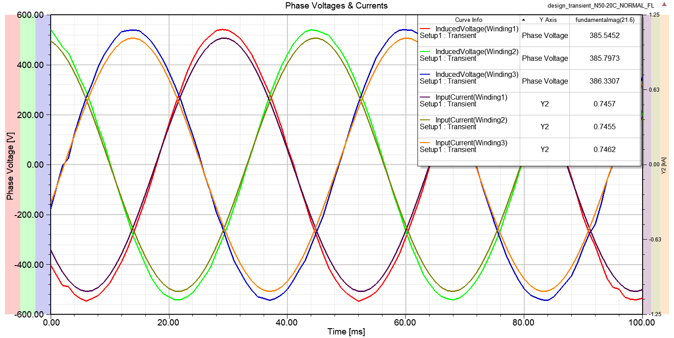
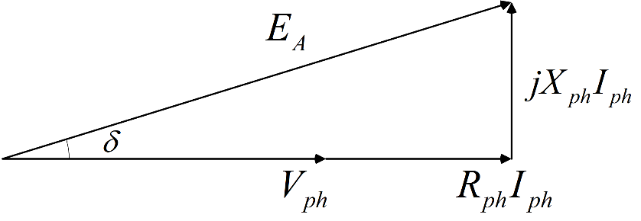
Phase voltage verification
Air cored, low frequency operation, low inductance structure
Phase reactance value do not become dominant in the calculation of phase voltage
Property | FEA Value (V) | Analytical Value (V) | Error
Phase voltage | 365.25 | 371.88 | 1.81%

Slide 38
Phase voltage verification
THD value is calculated as 2% for three windings
Winding | Harmonic No | Frequency (Hz) | Magnitude | % of Fund. Mag.
Winding-2 | 1st (Fundamental) | 21.6 | 547.67 | 100 %
 | 2nd | 43.2 | 1.30 | 0.24 %
 | 3rd | 64.8 | 8.53 | 1.56 %
 | 4th | 86.4 | 0.26 | 0.05 %
 | 5th | 108 | 0.61 | 0.11 %
 | 6th | 129.6 | 0.50 | 0.09 %
 | 7th | 151.2 | 0.71 | 0.13 %
 | 8th | 172.8 | 0.48 | 0.09 %
 | 9th | 194.4 | 0.90 | 0.16 %
 | 10th | 216 | 0.55 | 0.10 %

Slide 39
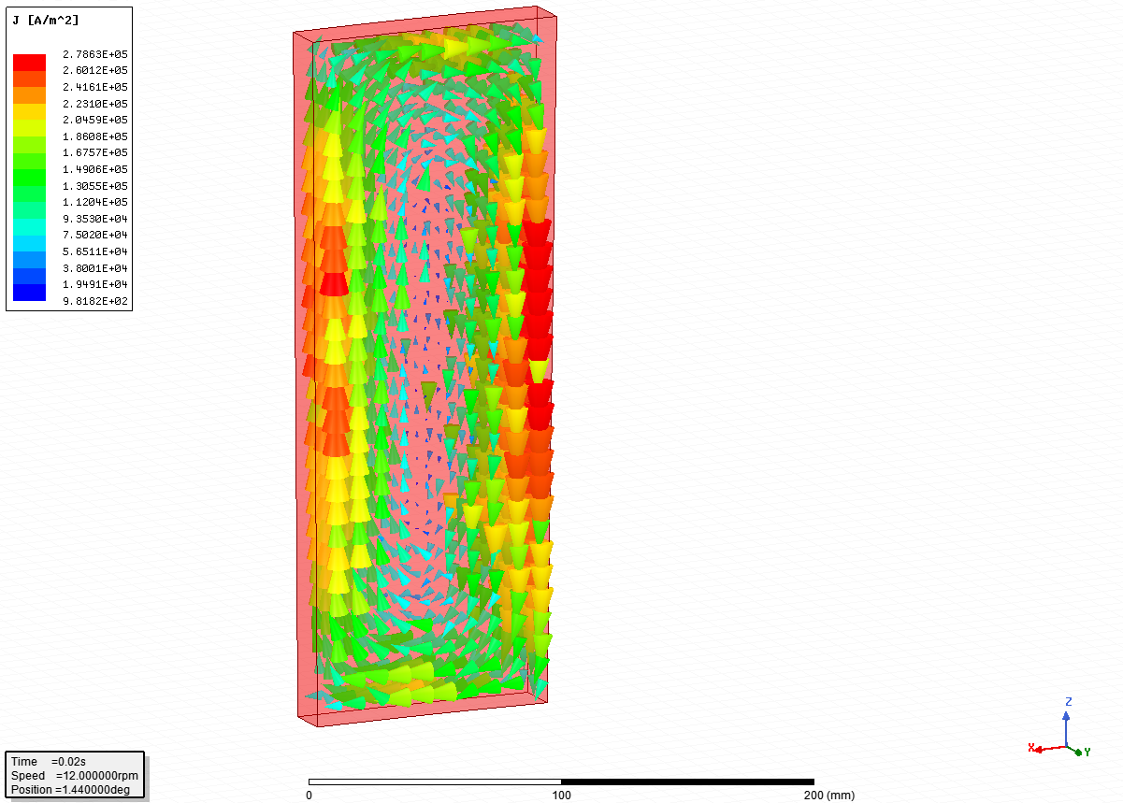
Eddy loss coefficient estimation
Total eddy loss for one magnet block is calculated as 9.97 W.
Total eddy loss on magnets is 28.8 kW which corresponds to 0.51% of total output power.
Eddy loss coefficient is estimated as 18 kW/m^3.

Slide 40
Comparison
Model | Type | Power (MW) | Speed (rpm) | Torque (kNm) | Mass (tonne) | Power Density (W/kg) | Torque Density (Nm/kg)
Thesis/Proposed | DD-PMSG | 5 | 12 | 3980 | 119.4 | 41.8 | 33.3
Harokasan | DD-PMSG | 1.5 | 18 | 796 | 47.2 | 31.7 | 16.8
Newgen | DD-PMSG | 4 | 19 | 2011 | 36.4 | 109.8 | 55.2
NREL-AMSC | DD-PMSG | 3.1 | 12.5 | 2370 | 90 | 34.4 | 26.3
Bang et. al. | DD-TFPM | 5 | 12 | 3980 | 90.8 | 55 | 43.8
NTNU Thesis | DD-PMSG | 10 | 13 | 7347 | 260 | 38.4 | 28.2
NREL-AMSC | DD-PMSG | 6 | 12.3 | 4658 | 177 | 33.9 | 26.3
NREL-AMSC | DD-PMSG | 10 | 11.5 | 8305 | 315 | 31.7 | 26.3
Bang et al. | DD-PMSG | 10 | 10 | 9551 | 325 | 30.7 | 29.3
Enercon/E-126-7580 | DD-EESG | 7.58 | 12 | 6035 | 220 | 34.4 | 27.4
The Switch/PMG4250-16 | DD-PMSG | 4.25 | 16 | 2537 | 89 | 47.7 | 28.5
The Switch/PMG3200-12 | DD-PMSG | 3.20 | 12 | 2547 | 80 | 40 | 31.8
The Switch/PMG1650-17 | DD-PMSG | 1.65 | 17 | 926 | 50 | 33 | 18.5

Slide 41
Conclusion
Designed AFPM generator has modularity, reliability, axial length and torque density advantages.
Highy efficiency due to omitted gear-box.
Main disadvantages of the proposed AFPM generator are magnet cost dependency, large diameter and mass.
Air cored structure, hence no core loss and cogging torque exist.
Design optimization is based on cost and considers real wind statistics and generation data.
Structural mass dominates the mass distribution while PM cost dominates the cost distribution.
Analytical design methodology is verified by FEA.

